Slide 1



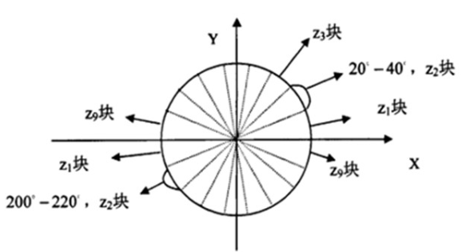
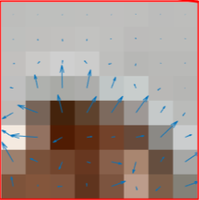
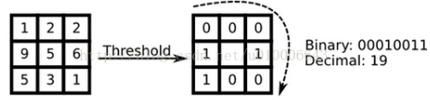
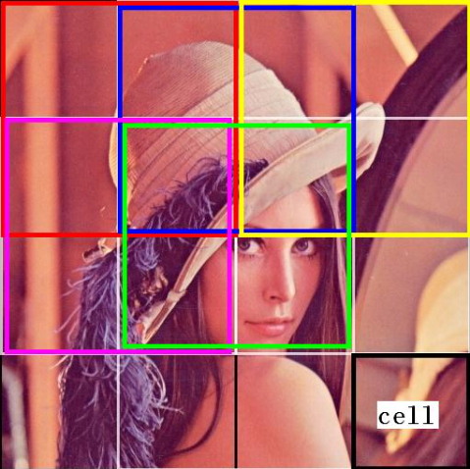
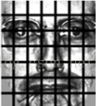


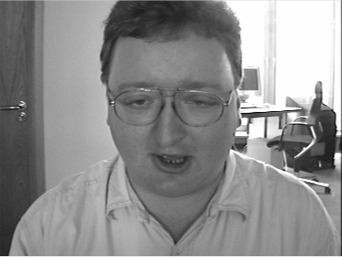
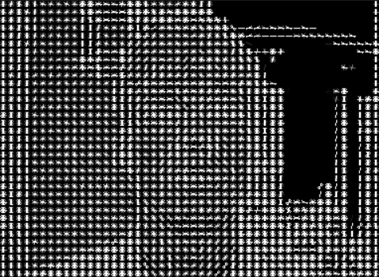
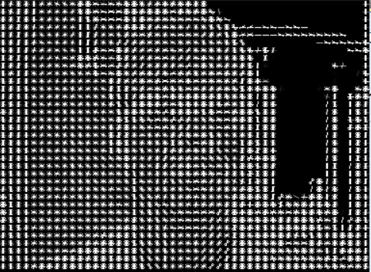
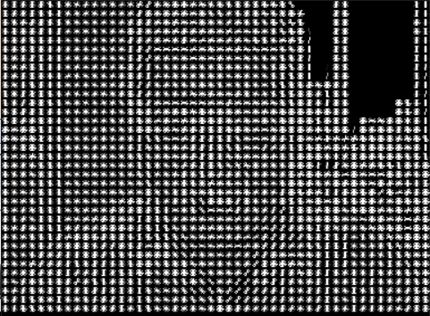
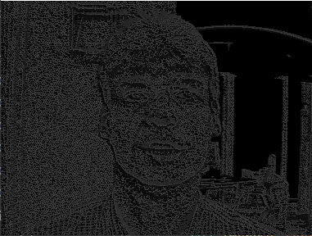
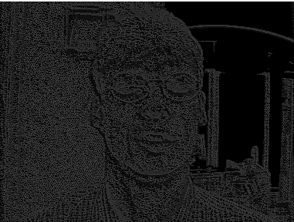
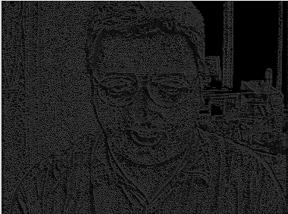
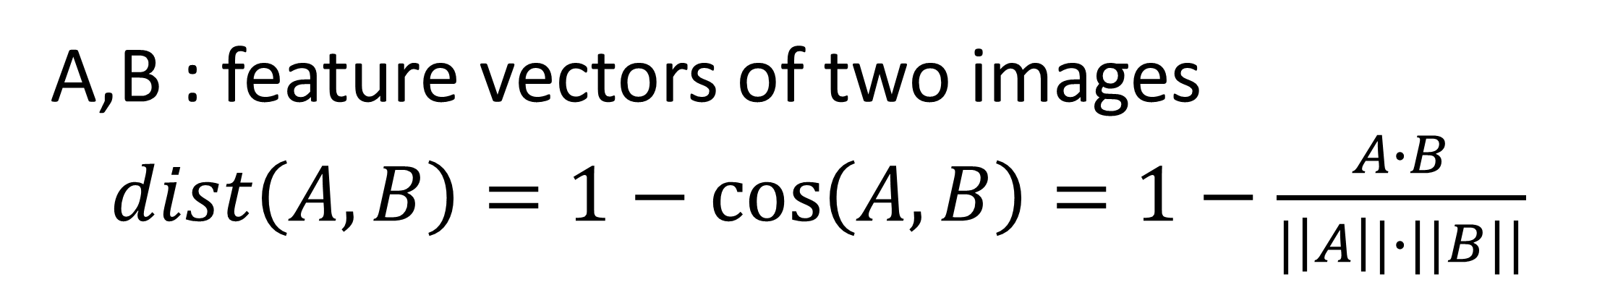
Face matching based on comparison of similarity
Xudong Zhang 12011923@mail.sustech.edu.cn
in
Introduction
Face matching is the process of comparing the face images detected in the static image or videos with the face images in the database to find out the matched faces, so as to achieve the purpose of identity recognition and identification.
Compared to classical algorithm which are based on global similarity, we perform face matching based on local similarity. We use histogram of gradient and local binary pattern for image segmentation and obtain feature vector of face by connecting various local feature vectors extracted from different positions in the face image in series. Then the similarity between faces is compared by calculating the cosine distance between the feature vectors
Main method
preprocessing
Calculate the Gradient Images
Calculate bit sequence
Replace by mapping decimal
16×16 Block Normalization
Calculate Histogram of Gradients in 8×8 cells
Normalization
Calculate Histogram in 16×16 cells
Uniform:
No more than two jumps
HOG
LBP
Performance
Cosine distance is used to measure similarity:
A,B : feature vectors of two images
$dist\left(A,B\right)=1−\cos\left(A,B\right)=1−\frac{A∙B}{|\left|A\right||∙||B||}$
 | 1 and 2 | 1 and 3 | 1 and 4
Perceptual hashing | 0.046875 (0.00031) | 0.421875 (0.00020) | 0.4375 (0.00021)
HOG | 0.122481 (0.40646) | 0.494636 (0.40112) | 0.494555 (0.40256)
LBP | 0.026489 (2.0196) | 0.168878 (2.01577) | 0.165048 (2.005324)
Department of
Electrical and Electronic
Engineering

